Slide 1

約．跑
全球獨創 表單約跑
填寫 | 送出 | 跑步

Slide 2
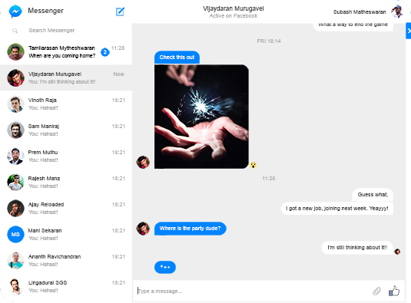
SidebarChatroom
interface SidebarChatroom {
id: string;
participant: User;
latestMessage?: LatestMessage;
unreadMessageCount: number;
};
interface LatestMessage {
id: string;
type: MessageType;
senderId: number;
preview?: string;
createdAt: Date;
};
enum MessageType {
Text,
Image,
Video,
File,
};
請見 Page 5, User
請見 Page 6, MessageType

Slide 3
Header
目前聊天的對象
目前使用者(自己)
請見 Page 5, User

Slide 4
ChatroomMessage
interface ChatroomMessage {
id: string;
type: MessageType;
senderId: number;
message: string;
createdAt: Date;
};

Slide 5
User
interface User {
id: number;
name: string;
avatarUrl?: string;
};

Slide 6
MessageType
enum MessageType {
Text,
Image,
Video,
File,
};

